Slide 1
  Other NSR Streamlining Issues
  Gale F Hoffnagle, CCM, QEP
October 11, 2018

Slide 2
Other Streamlining Issues
Aggregation
Ambient Air
Permitting Timeline
NSR/Title V Multiple Delay Opportunities
Commence Construction
Application Cutoff of Requirements
Status of BACT/RACT/LEAR Clearinghouse

Slide 3
Aggregation ( Adjacent)
The Clean Air Act says that “contiguous and adjacent” properties under the control of one business and its owner are all part of a “facility”. Since total emissions from a facility determine the minor/major status and often the permitting requirements, “adjacent” has become a policy stress point.
Many years ago it was decided that a mine and an adjacent power plant were two separate sources because they were different businesses.
When EPA started claiming that an entire oil field and all the wells, compressors and processing equipment were all one facility, the battle was joined.
Sugar mill example as well.
A Circuit Court decided that such a construct for oil fields was beyond the definition of “adjacent”. (Summit Petroleum)

Slide 4
Aggregation ( Adjacent)
On September 4, Bill Wehrum released a draft guidance that would narrow the scope of the geographical area to “physical proximity” rather than the prior EPA concept of
“ functional interrelatedness”.
•The oil and gas situation was decided in a policy memo in June 2016 that concluded that all oil and gas activities within a quarter mile were adjacent.
•The memo still leaves open the possibility of case-by-case determinations by the permitting authority.

Slide 5
Ambient Air
By policy, when determining whether a facility exceeds an NAAQS, the determination is made for locations that are “ambient air”
“Ambient Air” is defined by EPA as any place, external to buildings, to which the general public has access.
This generally means a fence or other barrier to public access. It often means more fence on the facility property than is needed for security control.
It also means that industries that have provided space on their land for ballparks or picnic areas are kept from doing so.
There are two policy issues discussed:
  When an allied or support company is resident on the plant property.
  When public access is hampered by other barriers.

Slide 6
Ambient Air – Support Facilities
Many large plants host support facilities to increase their ability to make a product. These include gas (oxygen, nitrogen, etc.) production facilities to feed a process, cogeneration facilities for steam and electricity, facilities to take the main process waste or by-products and create a separate product for sale, etc.
These separate facilities are inside the fence line of the primary plant. Are they ambient air for which modeled concentrations must be made. Agencies have argued that the workers at the support facilities are the general public.

Slide 7
Ambient Air – Support Facilities
The usual response to the question is that the main plant “owns and operates” the entire facility and only leases the land inside the facility to the support operations.
An additional position is that the personnel of the support operations are not the “general” public. They are allowed in by security, trained in plant safety procedures.
There have been many battles over these issues and a policy needs to be established.

Slide 8
Ambient Air - Barriers
When selecting receptors to put in the air quality dispersion models, permit applicants often argue about barriers to the general public.
Applicants are almost always told that the fence line is the general public boundary.
These barriers include
  Bodies of water
  Railroads
  Roadways
  Bridges
  Other industrial facilities

Slide 9
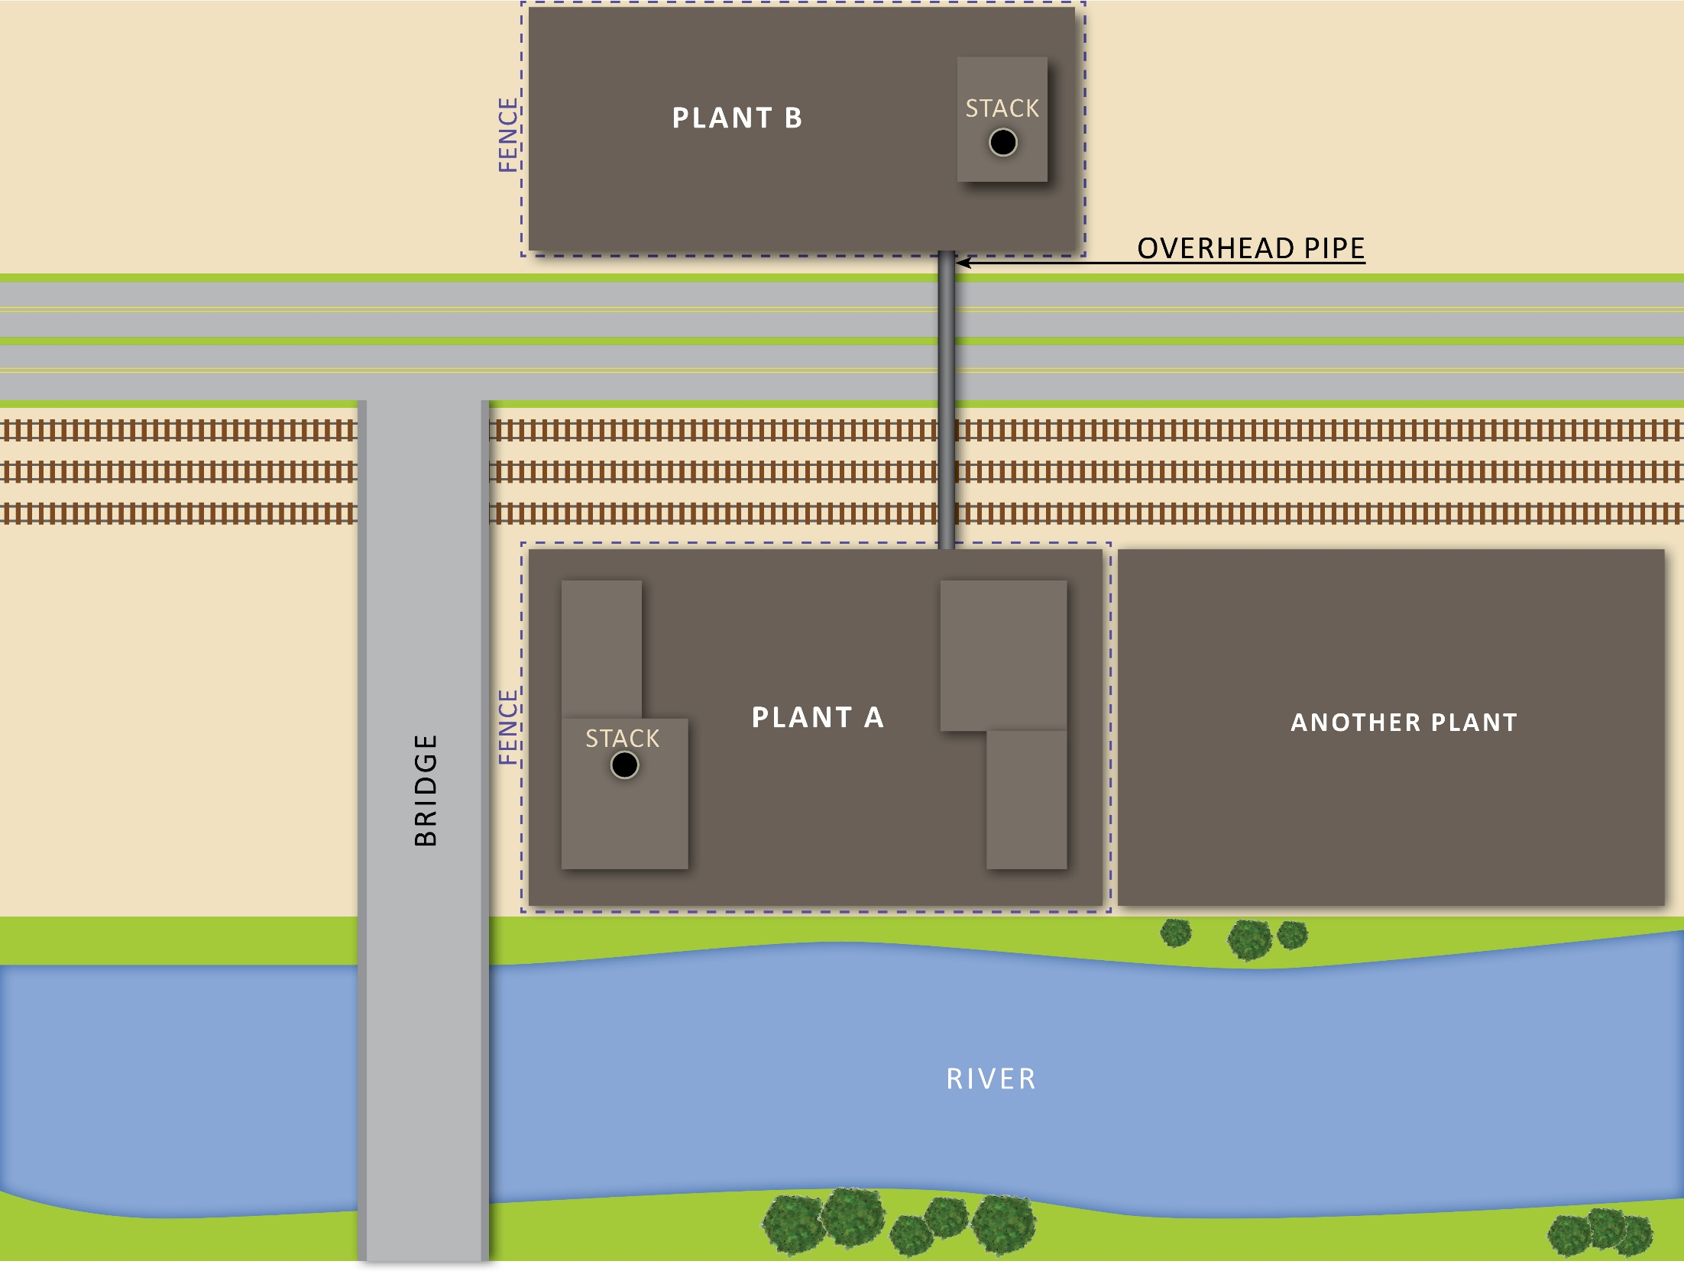

Slide 10
Time to Obtain a Permit
For “major” sources the permit time actually depends on obtaining two permits. The construction permit (NSR/PSD) and the operating permit (Title V).
The construction permit comes from the State in most cases and involves a time period for the State to obtain the data and draft a permit, have the hearings if necessary and issue the permit. That varies from State to State and with the type of facility proposed.
This time has expanded greatly as EPA has become more and more involved because the Supreme Court said EPA has the last word on Best Available Control Technology (BACT).
The State does make any steps without a least a nod from EPA.

Slide 11
Time to Obtain a Permit
The operating permit and Title V does not need to be issued under after a year of operation, but why would you build a new source that you cannot operate.
Many States issue the construction and operating permit together. Their reasoning is that if I spend and engineer’s time writing a permit, it is more productive to write them both together than having to go back a year later, perhaps with a different engineer, to do the same thing over again.
The Title V timeline is different and involves EPA directly
More importantly, EPA can veto a Title V permit. And has.

Slide 12
Permit Processing Flow Chart
EPA
CITIZENS
90
45
Appeal
Petition
Review
EPA
60
Informal
Review
FACILITY
STATE
STATE
STATE
Application
Completeness
Review
Draft
Permit
Public
Review
Response to
Comments
Issue
Permit
Permit
Appeals
Judicial
Review
60
30
Application
Shield
Affected
State
Review
50 Miles

Slide 13
Multiple Permit Delay Options
Environmentalists or NIMBY advocates have multiple opportunities in the permit process to delay or obfuscate. This leads to countless delay, more studies needing to be done to prove a negative, and greater expense.
The objective is to reduce these opportunities and speed the issuance of the permit.

Slide 14
Commence Construction
EPA policy is to insist that no site activities begin until the final permit is issued.
Some jurisdictions allow site clearing, grading and underground work to be done once the draft permit is issued. Famous 9th Circuit case.
Industry wants a broader policy on “commence construction”.

Slide 15
Application Cut-off Requirements
Once an application is deemed “complete”, industry would like the clock to stop on newly issued requirements to be applied to the facility.
New NAAQS, new NSPS, new MACT and new SIP requirements have often been used in the past by environmentalists to reopen ongoing permitting processes.
These new requirements can be handled under Title V.

Slide 16
BACT/RACT/LEAR Clearinghouse
An industry pet peeve is the R/B/L Clearinghouse where prior permitting decisions are supposed to be recorded.
More pressure or more money is needed for the States to record (accurately) the decisions made during permitting.
Even more important, but never previously tackled by EPA or the States are instances when BACT, RACT or LEAR was applied during the permit process but never worked once the facility was built.

Slide 17

Affordable Clean Energy Plan
Proposed August 21, 2018
Replaces Clean Power Plan

Slide 18
New Source Review
In order to ensure that the energy efficiency plans can be carried out in a timely manner, the proposed rule would nearer exempt the plans from NSR/PSD.
The exemption mechanism is to account for changes which trigger NSR only if maximum hourly emissions exceed past actual maximum emissions. As opposed to using annual emissions to determine applicability.
Four step NSR applicability process.
Energy efficiency improvements have often been the conflict between EPA and the utilities in the past.
Energy efficiency projects could lower the cost of coal fired power to make them used more in electricity dispatch and thus increase emissions on an annual basis.

Slide 19
Read More
If you want to read more you can go to the Regulations website and read the comments on the proposal, some scathing, (www.regulations.gov Docket EPA-HQ-OAR-2017-0355)

Slide 20
Gale F Hoffnagle, CCM, QEP
P: 860-298-6247 | E: ghoffnagle@trcsolutions.com
www.trcsolutions.com

